Slide 1


Data + Information Architecture
SETTING THE STAGE
data-action-lab.com

Slide 2
The (Messy) Analysis Process
Objective/
Rationale
Utilization and Decision Support
Data Collection
Data Exploration
Infrastructure and Data Management
Data Preparation
Modeling and Analysis
Communication

Slide 3
An Implemented (Automated) DATA Pipeline
In the service delivery context, you may eventually want one of these…
(9 component parts)
(as always - beware model ‘drift’!)

Slide 4


An Implemented (Automated) DATA Pipeline

Slide 5

Motivations For Collection
Three functions, historically:
Record Keeping (People/Societal Management!)
Science - New General Knowledge
Intelligence - Business, Military, Police, Social? Domestic? Personal!

Slide 6
Different Data Cultures, Different Terms
Business Intelligence:
data warehouse + data mart
data 'dimension’ (= data set)
hierarchical data (slices)
data element
dimension table + fact table
Science/Statistics:
experimental data
trials
participants
variables
correlation
Record Management:
information architecture
file plan
Information resource
field
form
subject
Data
Knowledge
Information
Data Science

Slide 7
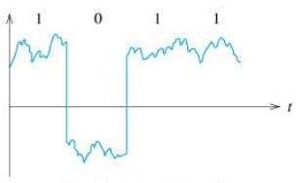
Enter Computers! And Computer Science!
Computer science (and information science) has its own theoretical, fundamental viewpoint about data, and information.
Computers operate over data in a fundamental sense - 1s and 0s that represent numbers, letters, etc. – data becomes digital.
Pragmatically, data is now stored on computers, and is accessible through our world-wide computer network.

Slide 8

Data DECAYS
Data ages over time - it has a shelf life.
We use the phrase "rotten data” or "decaying data”:
literally - in the sense that the data storage medium might decay
metaphorically - when the data no longer accurately represents the relevant objects and relationships or even when those objects no longer exist in the same way
Your data must be ‘fresh’, ‘current’, not ‘stale’ (context and model dependent!)

Slide 9
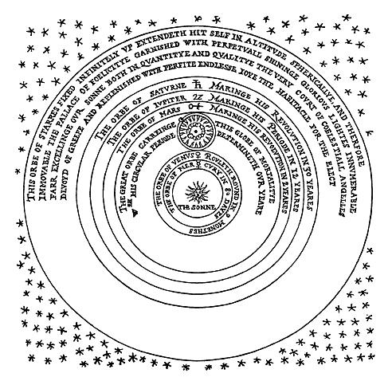
Core Concepts
How do we cut across all of the different disciplines that use data?
Core (systems) concepts or elements:
object – attributes (concrete or abstract)
multiple objects - relationships between these objects/attributes
how these elements change over time

Slide 10
Relationships Within Systems
some fundamental relationships:
part-whole
is-a
is-a-type-of
cardinality (one-to-one, one-to-many, many-to-many)
some more object specific relationships:
ownership,
social relationships
becomes,
leads-to

Slide 11
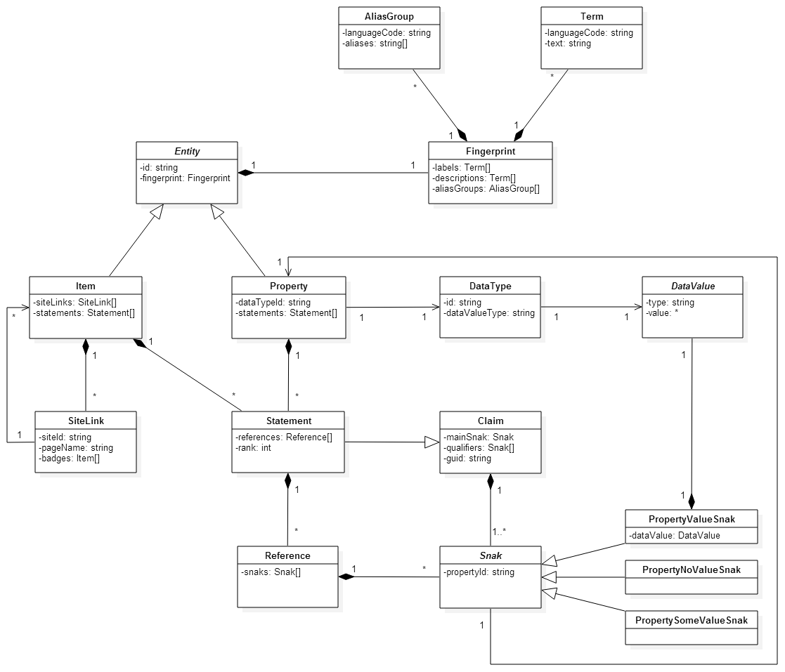
Formal Conceptual Modelling Languages
Conceptual modelling is not an exact science – it’s more about making your internal conceptual models explicit and tangible.
It provides you with an opportunity to examine and explore your ideas and assumptions.
That said, various efforts have been made to formalize conceptual modelling:
UML – Universal Modelling Language
Entity Relationship (ER) Models - but they are generally connected to relational databases

Slide 12
Methodological Models
Mathematical Model
Statistical Model
Conceptual Model
Programmatic (Computer) Model
Ontology (Knowledge Model)
(Simulation)
Data Model

Slide 13
An Implemented (Automated) DATA Pipeline
Do they match? Each other? The conceptual model?
Data Model
Mathematical Model
Statistical Model
Programmatic Model

Slide 14
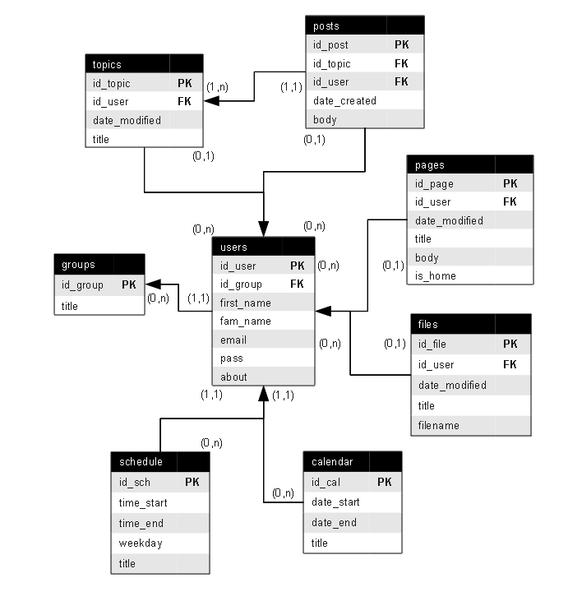
What Is Data Modelling
A data model is an abstract (logical) description of a system, constructed in terms that can then be implemented as the structure of a type of data management software.
You might argue that it is half way between a conceptual model and a database implementation.
The data itself is about instances – the model is about the object types.
There is another option that is worth considering on this front – ontologies.

Slide 15
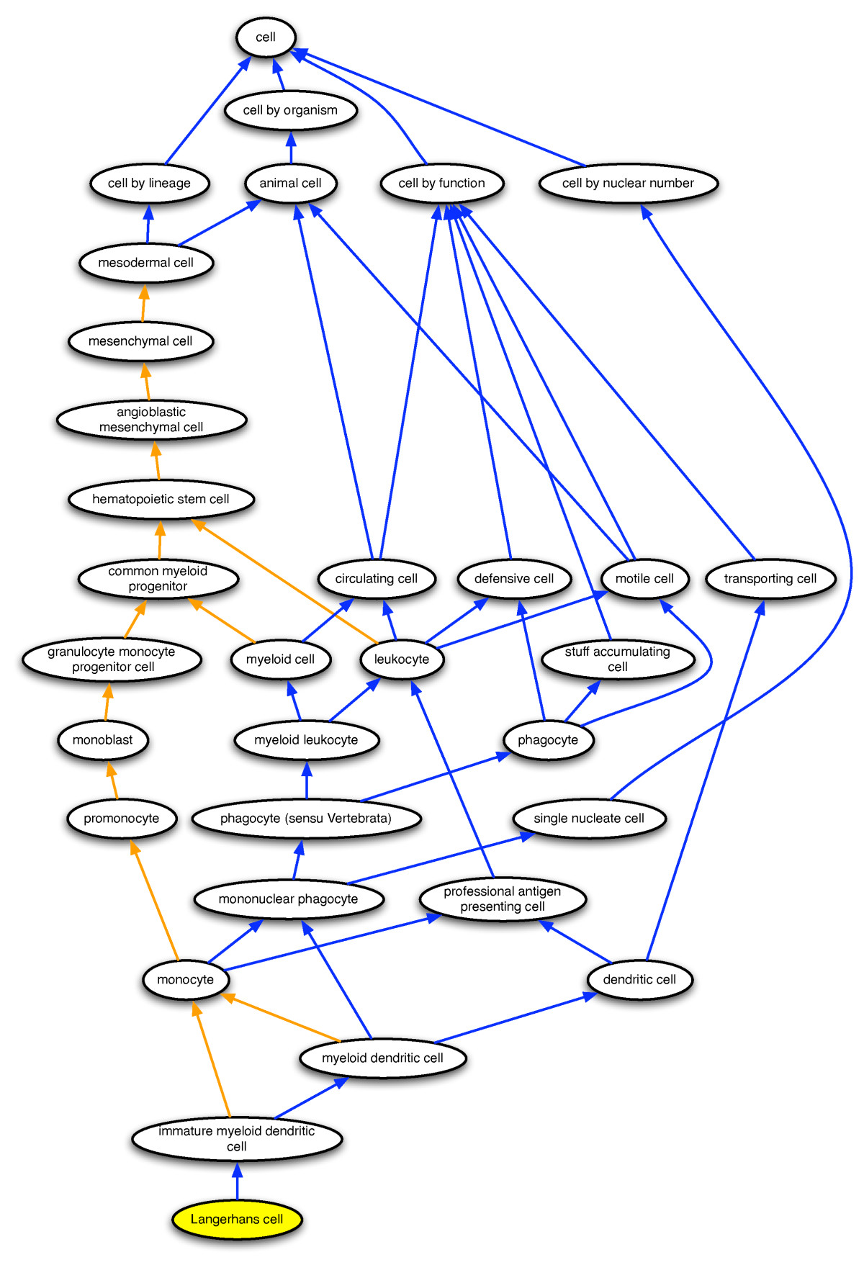
Ontology – Knowledge Model
A structured, machine-readable collection of facts about a domain.
Motivated by a desire to create increasingly machine readable but still conceptually sophisticated data.
you could describe in a slightly tongue in cheek manner as 'a data model on steroids’.
An attempt to get closer to the level of detail of a full conceptual model.

Slide 16
Metadata To Provide Context
We lose something when we move from our conceptual model to a specific type of model – e.g. the data or knowledge model.
One way of keeping the context is to provide (hopefully rich) metadata – data about our data!
Metadata is crucial when it comes to carrying out strategies for working across datasets.
Ontologies can also play a role here!

Slide 17

Structured vs Unstructured Data
A major motivator for some of the new developments in types of databases and other data storing strategies is the increasing availability of unstructured data and also 'blob' data.
Structured Data: labelled, organized, discrete, structure is constrained and pre-defined
Unstructured Data: not organized, no specific pre-defined structure data model – e.g. text in a document
Blob Data: Binary Large Object (BLOb) – images, audio, multi-media

Slide 18
What Is Data Modelling
We're going to look at four different options that are currently popular in terms of fundamental data and knowledge modelling or structuring strategies:
key-value pairs (e.g. JSON)
triples (e.g. resource description framework (RDF))
graph databases
relational databases
NoSQL

Slide 19
Key - value stores and triple stores
These are relatively unstructured ways to store data:
Key Value: all data is simply stored as a giant list of keys and values, where the key is a name or label (possibly of an object) and the value is a value associated with this.
Triple: Data is stored as subject – predicate – object

Slide 20
Examples
apple type - apple colour
Granny Smith - green
Red Delicious – red
person - shoe size
Jen Schellinck - women's size 7
Colin Henein - men's size 10
word - definition
url – webpage
report name – report (document file)
Triples add a verb to the mix:
Person - is - age
Object - is-colour - colour

Slide 21
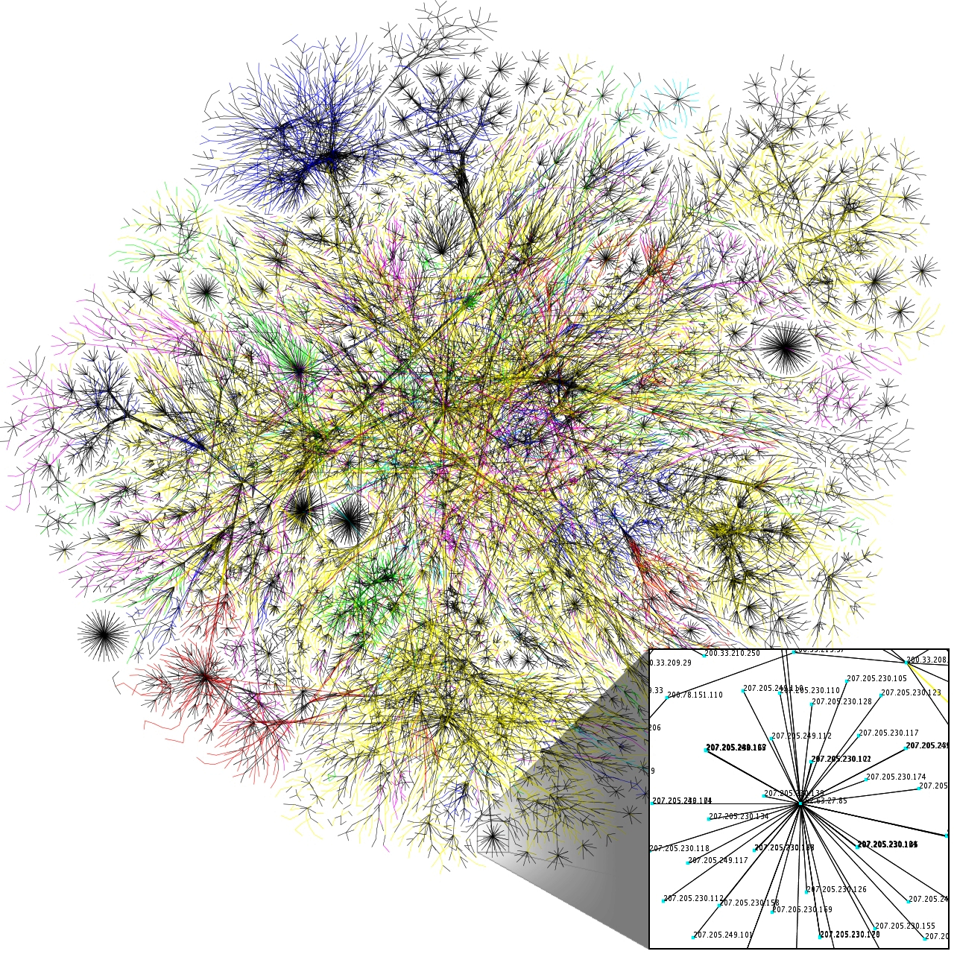
Graph Databases
Emphasis on the relationships between different types of objects, rather than between an object and the properties of that object.
The data model:
objects represented by nodes
relationships between these objects represented by edges
objects can have a relationship with other objects of that same type - person is-a-sibling-of person

Slide 22
Relational databases
Data stored in a series of tables
Broadly speaking, each table represents an object and some properties related to this object.
Special columns in tables connect object instances across table.

Slide 23
Pros, Cons and Use Cases of Each
Relational Database: widely supported, well understood, works well for many types of systems and use cases. But difficult to change once implemented, doesn't deal with relationships well (despite the name).
Key-Value Stores: can take any sort of data, don't need to know much about it's structure advance, if you have many missing values these won't take up space. But can be messy and mysterious, difficult to find data.
Graph Databases: fast and intuitive if you are using heavily relation-based data, might be the only option if your data is like this because traditional databases may slow to a crawl. But probably overkill/too specialized if your data is not like this, not yet widely supported.

Slide 24
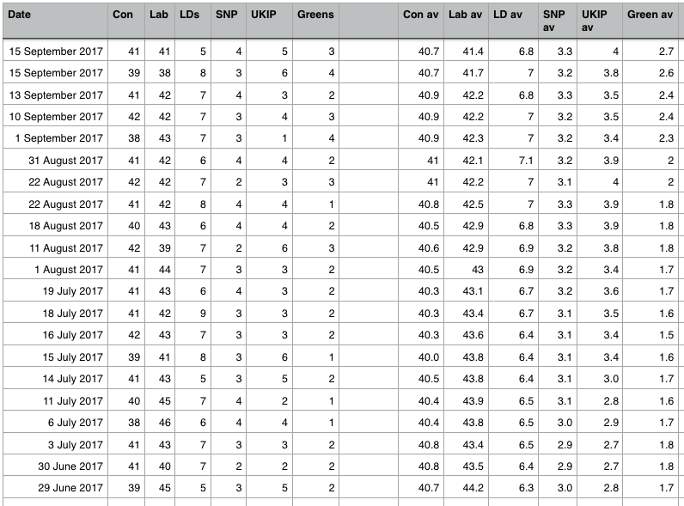
A note on flat files and spreadsheets
What about keeping your data in a single giant table (spreadsheet)? Or multiple spreadsheets? How bad can it be?
Wayne Eckerson coined the term ‘spreadmart’ (as opposed to data mart) to describe a situation with many (ad hoc) spreadsheets as a data strategy.

Slide 25
A note on flat files and spreadsheets
Pros - very efficient if you are only collecting data once, about one particular type of object (e.g. scientific studies!), some types of analysis require you to have all the data in one place, so you are going to need to generate a flat file anyway. Easy to read into analysis software (e.g. R) and do operations over the entire dataset
Cons - very hard to manage data integrity over the long term if you are continually collecting and working with the data. Doesn't work well if you are dealing with data on a system involving many different types of objects and their relationships. Can be very difficult to carry out data querying operations

Slide 26
Some Tools and Buzzwords
Linked Data
Semantic Web
Web Ontology Language (OWL)
Protégé
MongoDB, ArangoDB
Document store
JSON, YAML
API, GraphQL

Slide 27
Implementing Your Model
To implement your data/knowledge model, you need to have access to data storage and management software.
Access might be challenging for you, the individual, because traditionally such software runs on servers.
Servers are good because they allows many people to access a single database at the same time, from different client programs. However, it makes it hard to 'play' with a database.
SQLite to the rescue!

Slide 28

Role of Data Management Software
Data management software provides humans with an easy way to interact with their data.
It’s essentially a human – data – interface.
Through this interface you can:
add data to your data collection
extract subsets of data from your collection based on certain criteria
delete or edit data in your collection

Slide 29
A Data What???
Previously:
Database
Data warehouse
Data Marts
Database Management System
(SQL)
Now:
Data Lake
Data Pool
Data swamp?
Data graveyard?
(NoSQL)
Increasingly more of a distinction between the data store and the data management software

Slide 30
From Data Model TO Implementation
What do we do once we’ve completed a (logical) data model?
instantiate the model in your chosen software (e.g. create tables in MySQL)
load the data
query the data:
Traditional relational databases use Structured Query Language (SQL)
Other types of databases use entirely different query languages (AQL, semantic engines, etc.) or rely on bespoke computer programs (e.g. written in R, Python)

Slide 31
Data Collection Management
Once you’ve created a data collection, you must also manage it! What does this mean? Fundamentally, it means maintaining data in the database that is:
accurate,
precise,
consistent
complete
Don’t let your data lake turn into a data swamp…

